Slide 1
Yulia Dwi Susanti
BUSINESS DATA ANALYST TEST FOR INVESTREE PHILIPPINES

Slide 2
SOAL 1

Slide 3
A. Designing Dashboard (visual report) for managements decision support system
1. Mock up dashboard that can help investree’s management to oversee and evaluate business development.
Answer:
Data processing:
1. The data was obtained from open source data (loan data).
2. The data should be cleaning due to some null data which can impact to the data analysis process. Hence, we also have to check the duplicated data from the dataset.

Slide 4
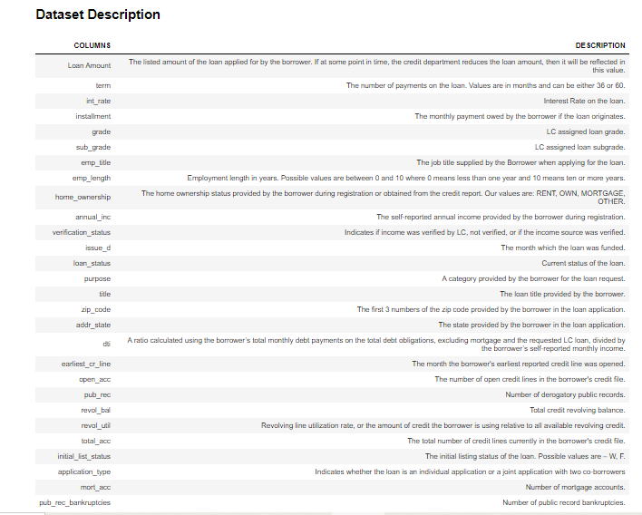
Data Preprocessing
Data Set Description from the loan dataset

Slide 5
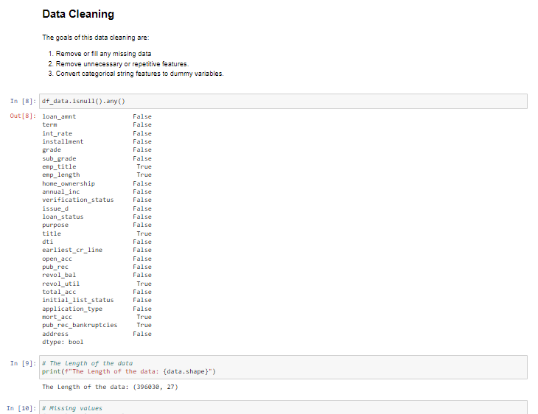
Data Preprocessing
Data cleaning process. The preprocessing data was also attached in attachment. We have to check the null data from the numerical data and categorical data.

Slide 6
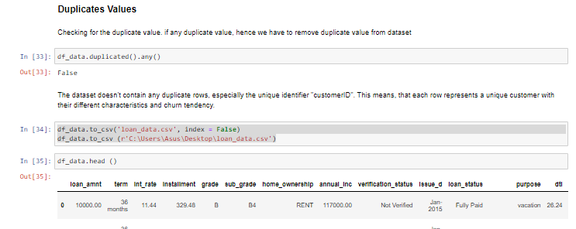
Data Preprocessing
We also have to check is there any duplicated values or no. After the data was cleaned, we can processs for the data analysis.

Slide 7
A. Designing Dashboard (visual report) for managements decision support system
1. Mock up dashboard that can help investree’s management to oversee and evaluate business development.
Answer:
Data Analysis:
The data was processed using Tableau as can be seen at the next page.
Getting insight or summary from the data analysis.

Slide 8
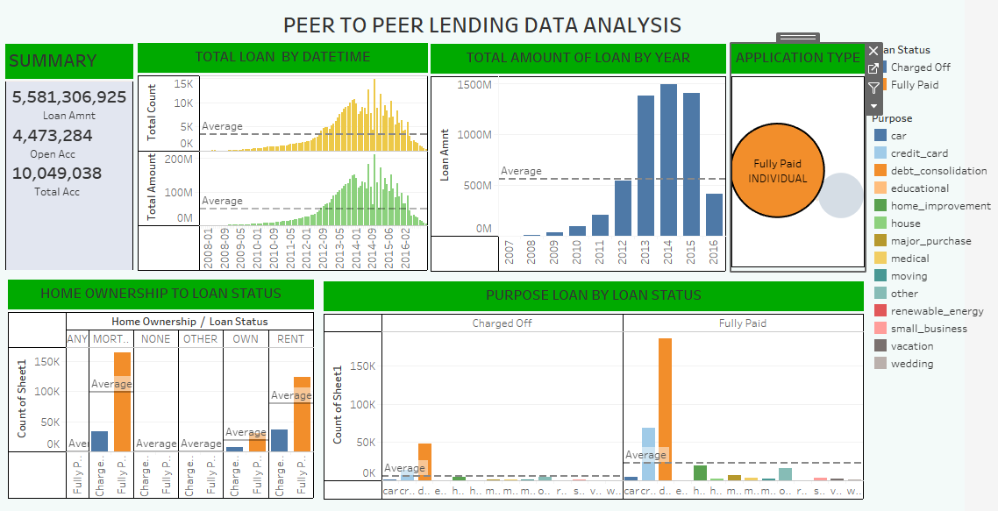
LOAN DATA ANALYSIS

Slide 9
Insight 1
The loan amount of the application from 2007 untl 2016 reach 5,581,306,925.
The loan amount and loan account was increased from 2007 until around 2014 while around 2014 until 2016 the loan account and loan amount was decreased.
The increase of loan amount was followed by the increased of loan account and vice versa.
The loan amount and loan account was higher than average start from 2012 to 2014. While 2014 until 2016 the loan amount and loan account didn’t reach loan average.

Slide 10
Insight 2
The total of loan amount was increased from 2007 until 2014 while 2015 and 2016 the total of loan amount was decreased.
The application type of loan by this data whch is fully paid and charged of was generally applied by individual.
The purpose of loan which is fully paid dominated with the purpose of debt consolidation.

Slide 11
Additional analysis
For this data, I also making data analysis for the distribution, univariate analysis, multivariate analysis, and correlation between variable as can bee seen at the next page where I do an analysis using jupyter notebook.

Slide 12
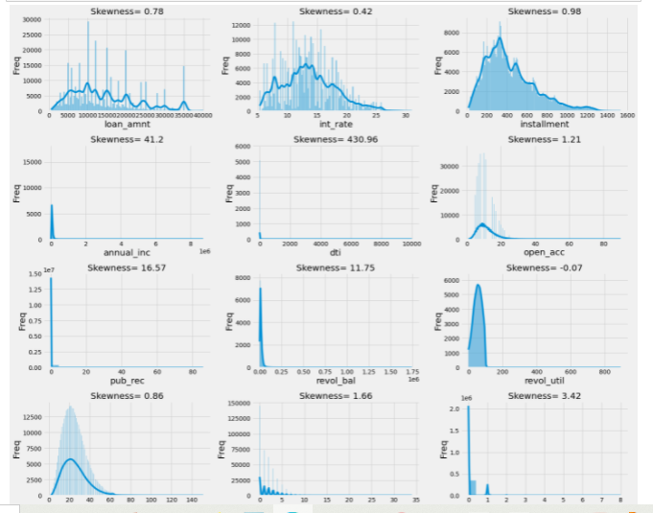
1. Univariate Analysis
Based on the histogram above, we can see the frequency of occurrence of each bin of values. All of them are positively skewed except for revol_util.

Slide 13
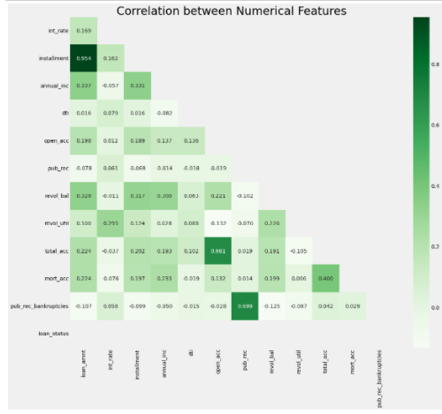
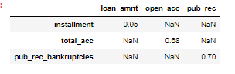
1. Multivariate Analysis
Some numerical features are correlated, strong correlation, and very strong correlation. Those who have correlations with another predictor, need to be removed if we want to try a linear-based or specifically logistic regression model. Due to the assumption underlying the model:

Slide 14
SOAL 2

Slide 15
A. Designing Dashboard (visual report) for managements decision support system
2. Recommend data driven initiatives, that according to your current understanding can be used as adeas for campaigning as ideas for campaigning/experiment/pilot to be tested by investree.
Answer:
1. Peer to Peer Lending Application Prediction
identify the risky applicants is the largest source of financial loss (called credit loss)
2. Bank Marketing campaign opening a term deposit
K-Means Clustering to cluster type of customer to increase their funding amount based on their characteristic such as funding rate, sex, education, funding transaction, and etc. This model can help decision maker to make promotion based on funding customer characteristic or cluster.

Slide 16
Peer to Peer Lending Application Prediction

Slide 17
A. Introduction
This data was obtained from loan data in peer to peer lending company headquartered in San Francisco, California. It was the first peer-to-peer lender to register its offerings as securities with the Securities and Exchange Commission (SEC), and to offer loan trading on a secondary market.
Solving this case study will give us an idea about how real business problems are solved using EDA and Machine Learning. In this case study, we will also develop a basic understanding of risk analytics in banking and financial services and understand how data is used to minimise the risk of losing money while lending to custo

Slide 18
B. Objective
The objective of this project is to identify the risky applicants is the largest source of financial loss (called credit loss). The credit loss is the amount of money lost by the lender when the borrower refuses to pay or runs away with the money owed. In other words, borrowers who defaultcause the largest amount of loss to the lenders. In this case, the customers labelled as 'charged-off' are the 'defaulters'.

Slide 19
C. Data set Description
Data Set Description from the loan dataset

Slide 20
D. Data Preprocessing
Data cleaning process. The preprocessing data was also attached in attachment. We have to check the null data from the numerical data and categorical data.

Slide 21
D. Data Preprocessing
We also have to check is there any duplicated values or no. After the data was cleaned, we can processs for the data analysis.

Slide 22
E. Exploratory data abalysis

Slide 23
- Univariate Analysis
Based on the histogram above, we can see the frequency of occurrence of each bin of values. All of them are positively skewed except for revol_util.

Slide 24
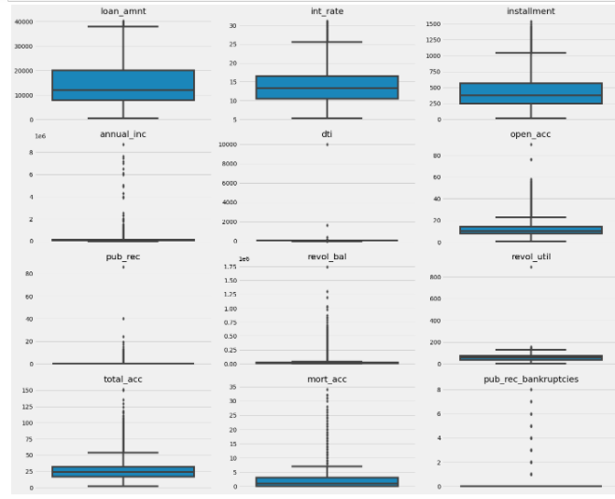
- Univariate Analysis
Using a boxplot, we can see the outliers more clear than the histogram. This will be beneficial in evaluating after outlier treatments.

Slide 25
- Multivariate Analysis
Some numerical features are correlated, strong correlation, and very strong correlation. Those who have correlations with another predictor, need to be removed if we want to try a linear-based or specifically logistic regression model. Due to the assumption underlying the model:

Slide 26
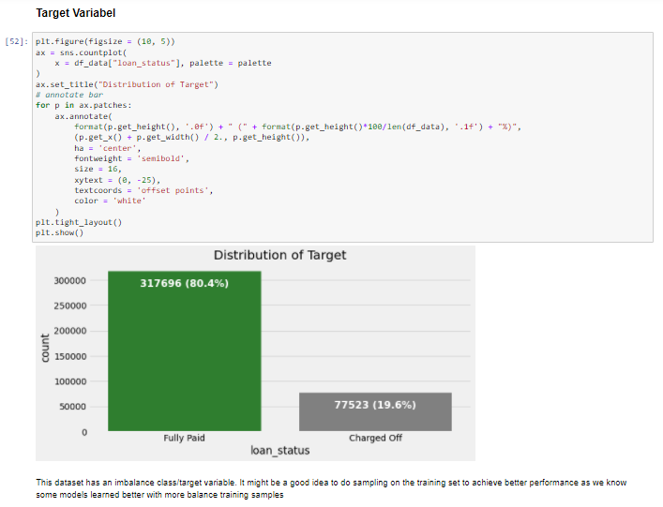
- Target variabel
This dataset has an imbalance class/target variable. It might be a good idea to do sampling on the training set to achieve better performance as we know some models learned better with more balance training samples

Slide 27
F. Removing Outliers

Slide 28
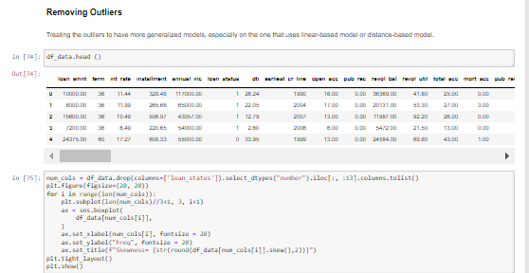
F. Removing Outlier
Transformed only the features that have skewness > 0.5. or < -0.5. We also need to take a closer look at the information contains by each variable. There might be more than one solution to treat the outlier.
If we investigate each numerical variable, there are some numerical variables that originated from a nominal categorical variable. In this particular dataset, they are OperatingSystems, Browser, and Region. The outliers in these 3 features, can be transformed into a one-hot encoding. But before doing one-hot encoding, we have to group them into a bin of most frequent value and the least frequent value. Some of the most frequent values will be put in one group alone, and the least frequent will be grouped into one group.

Slide 29
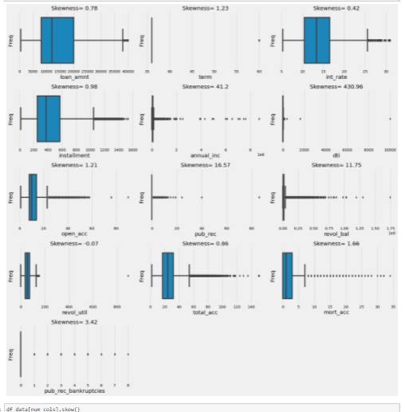
F. Removing Outlier
Transformed only the features that have skewness > 0.5. or < -0.5. We also need to take a closer look at the information contains by each variable. There might be more than one solution to treat the outlier.
If we investigate each numerical variable, there are some numerical variables that originated from a nominal categorical variable. In this particular dataset, they are OperatingSystems, Browser, and Region. The outliers in these 3 features, can be transformed into a one-hot encoding. But before doing one-hot encoding, we have to group them into a bin of most frequent value and the least frequent value. Some of the most frequent values will be put in one group alone, and the least frequent will be grouped into one group.

Slide 30
G. Split data set and Normalizing data

Slide 31
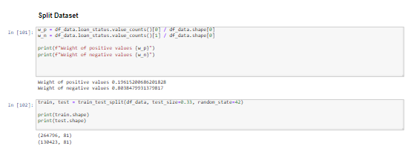
a. Split data set
The dataset was splitted into training data set and testing data set

Slide 32
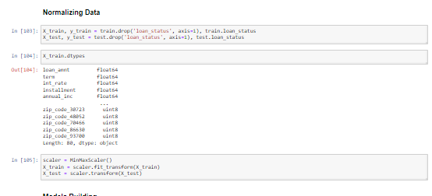
B. Normalizing data

Slide 33
H. Model Building

Slide 34
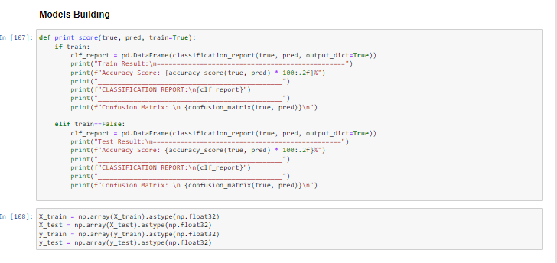
H. Model Building
Artificial Neural Network
Decision Tree
Random Forest
XGBoost

Slide 35
I. Results

Slide 36
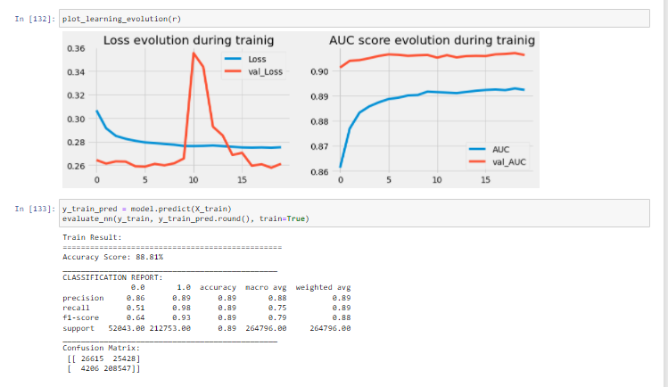
- Artificial Neural Netword

Slide 37
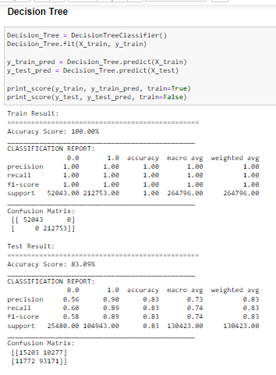
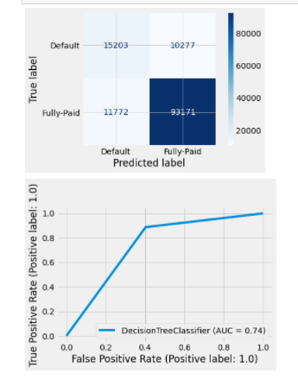
- Decision Tree

Slide 38
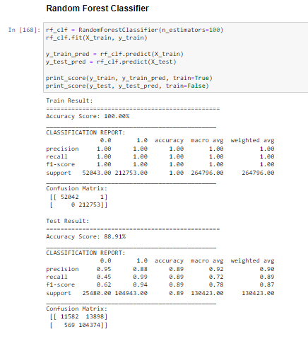
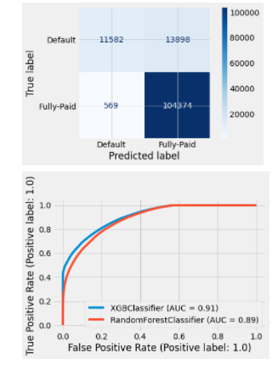
- Random Forest

Slide 39
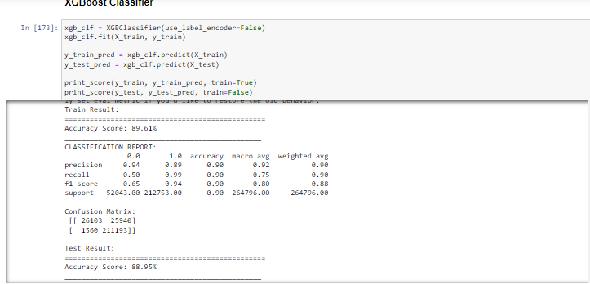
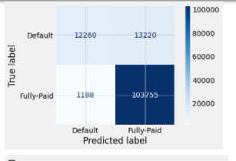
- XGBoost

Slide 40
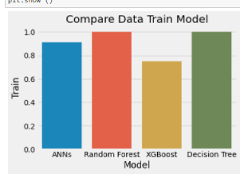
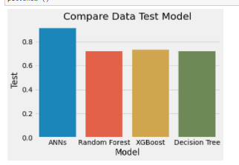
Compare Model
Amongst the features/predictors, the 3 most important features are total_acc, annual_inc, and loan_amnt. If we compare to EDA steps, this seems familiar as we previously have detected significant differences between the value for class 0 and class 1 in these features. Also, if we take a look at the correlation matrix, this feature show correlated, strong correlation, and very strong correlation

Slide 41
For the complete analysis can find at email attachment for .Py file or can be accessed within this link https://github.com/dwyulia24/Investree-business-data-analyst/blob/main/Investree_Lending%20application%20prediction.ipynb

Slide 42
THANK YOU

